Slide 1
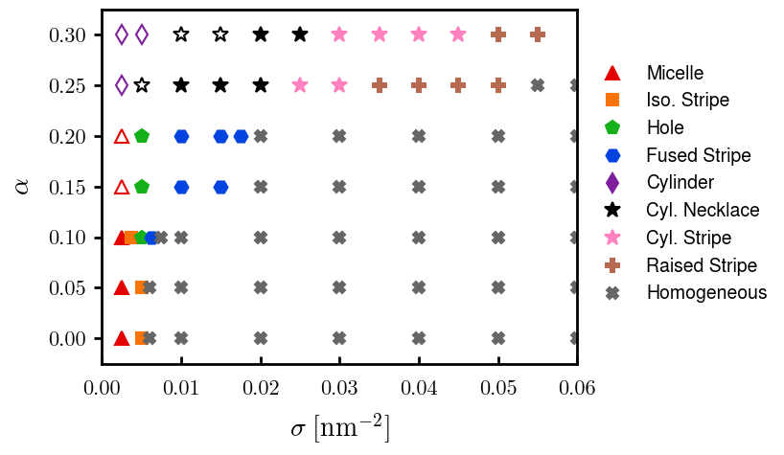
Current runs on phase diagram,

Slide 2



a00s3e3 - DONE
F= -1.77969
F = -1.77893
F= -1.77588, unstable

Slide 3










a00s5e3 - DONE
F = -2.986
F = -2.98574
F = -2.98733
F = -2.98580
F = -2.98637
F = -2.98644

Slide 4


a00s6e3 - DONE
F = -3.59170
F = -3.59404

Slide 5


a00s7e3 - DONE
F = -4.20090
F = -4.20224
Terran tried stripe (15.2, 20.2) & (12.2, 20.2). Unstable

Slide 6



a05s3e3 - DONE
F = -1.77283
F = -1.77232
F = -1.77005

Slide 7



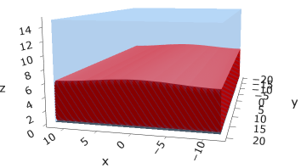
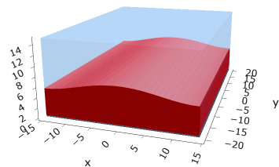
a05s5e3
F = -2.97229
F = -2.97422
F = -2.97319
F = -2.97365

Slide 8



a05s6e3 - TERRAN
F = -3.57664
F = -3.57732
F = -3.57783

Slide 9



a05s7e3 - DONE
F = -4.18090
F = -4.18116
F = -4.18226

Slide 10
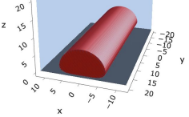
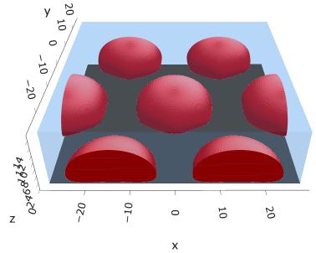
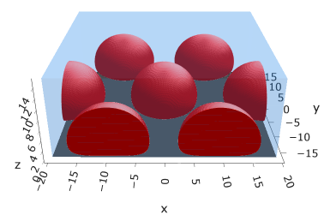
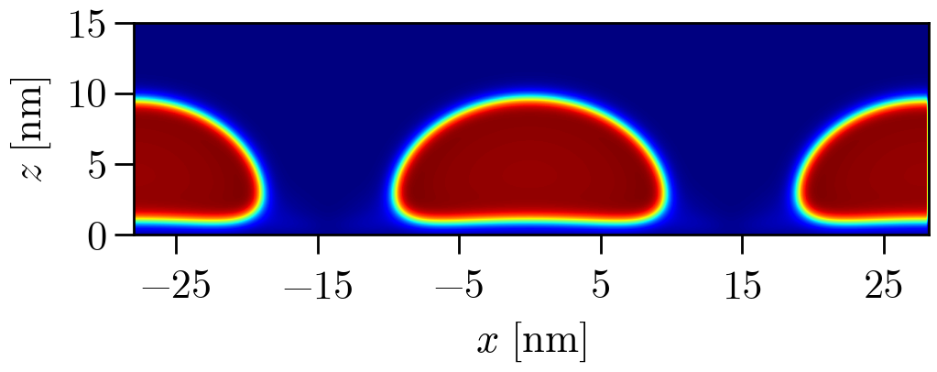
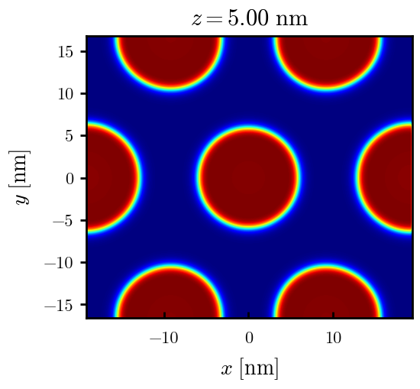
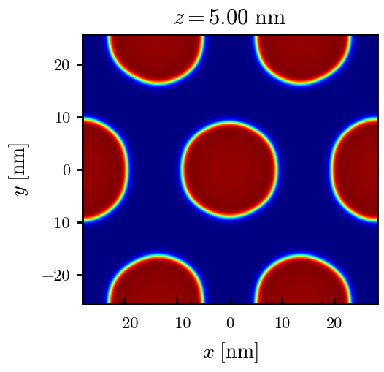
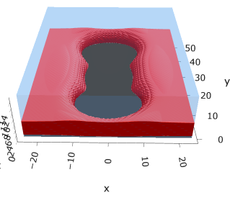
a10s2.5e3
Np / mic = 2
F = -1.45840
Np / mic = 1
F = -1.45667
F = -1.45929
F = -1.45546

Slide 11
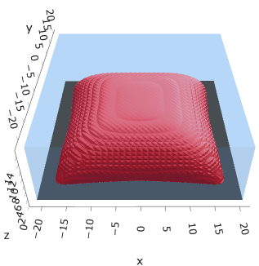
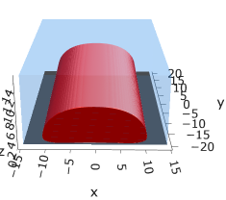
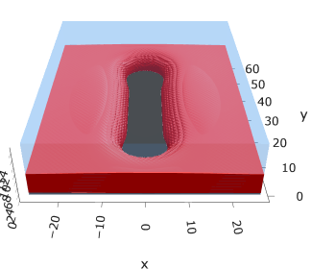
a10s3.75e3
F = -2.19744
F = -2.19763
F = -2.19618

Slide 12
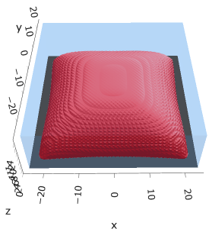


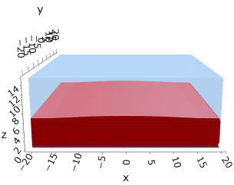
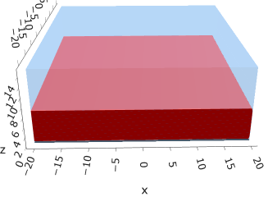

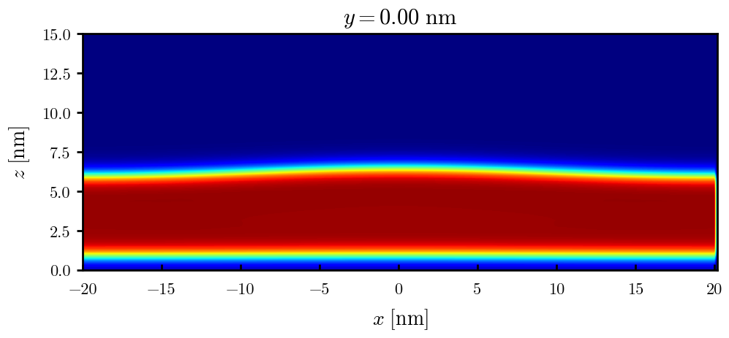

a10s5e3
F = -2.93747
F = -2.93851
F = -2.93859
F = -2.93847
F = -2.93848

Slide 13
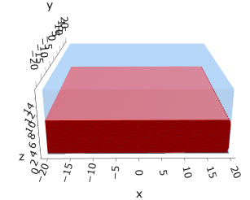
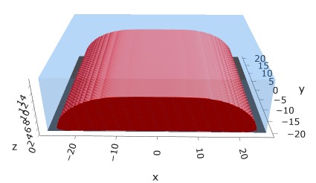
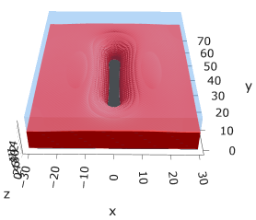
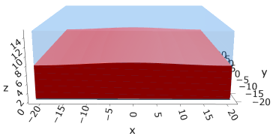
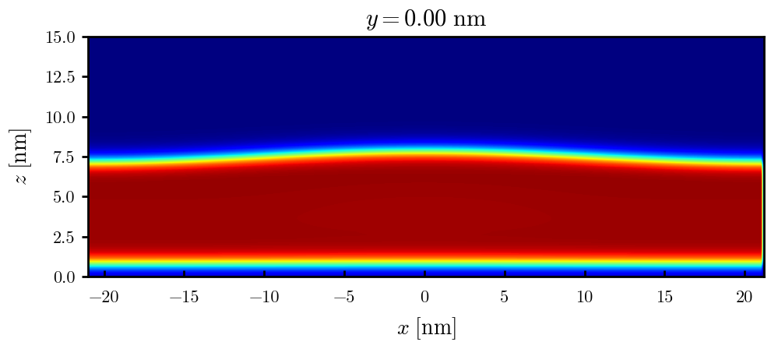
a10s625e3
F = -3.68015
F = -3.68121
F = -3.68176
F = -3.68177

Slide 14

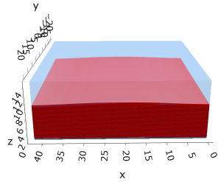

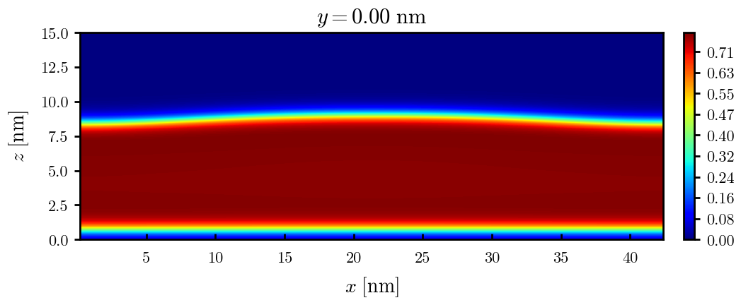
a10s0075
F = -4.42442
F = -4.42465
F = -4.42466

Slide 15


a10s010 - DONE
F = -5.90899
F = -5.90938
Josh tried hole. Unstable

Slide 16
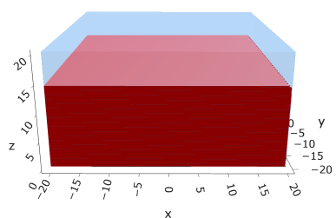
a10s0125
F = -7.39229

Slide 17
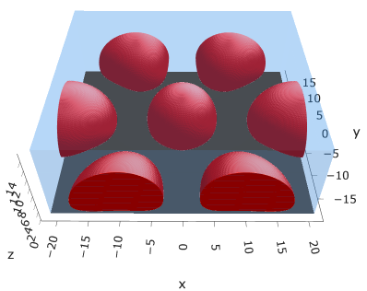
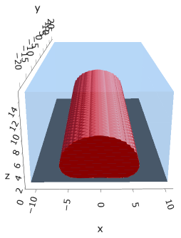
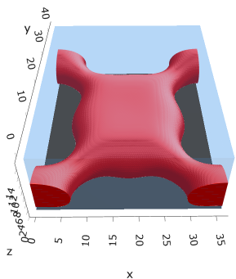
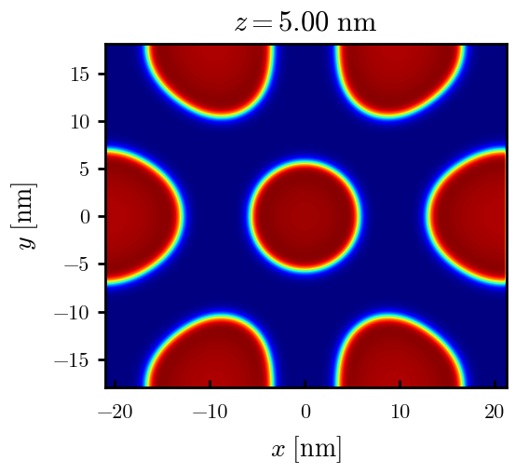
a15s2.5e3
F = -1.43718
F = -1.43723
F = -1.43609

Slide 18
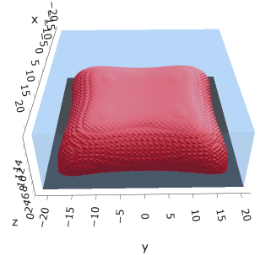
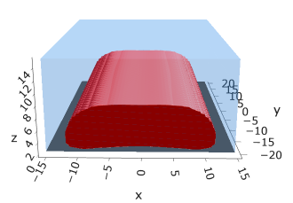
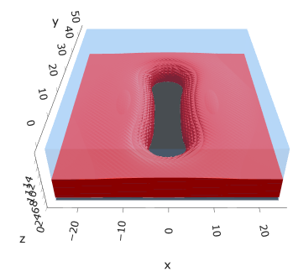
a15s3.75e3
F = -2.16108
F = -2.16133
F = -2.16077

Slide 19
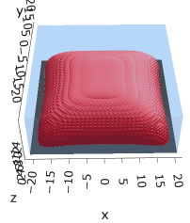



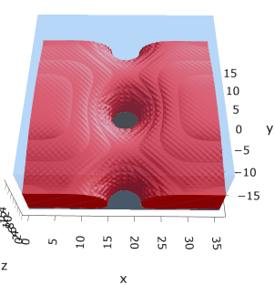
a15s5e3
F = -2.88511
F = -2.88602
F = -2.88654
F = -2.88482

Slide 20
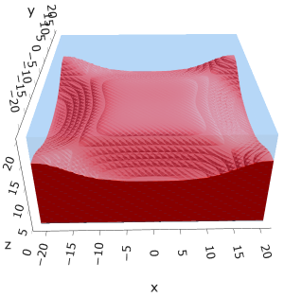

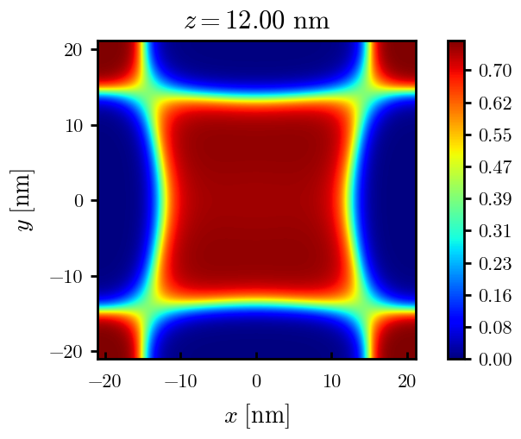
a15s1e2
F = -5.78561
F = -5.78588
Tried hole and didn’t work

Slide 21
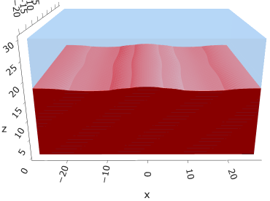
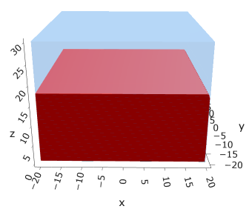
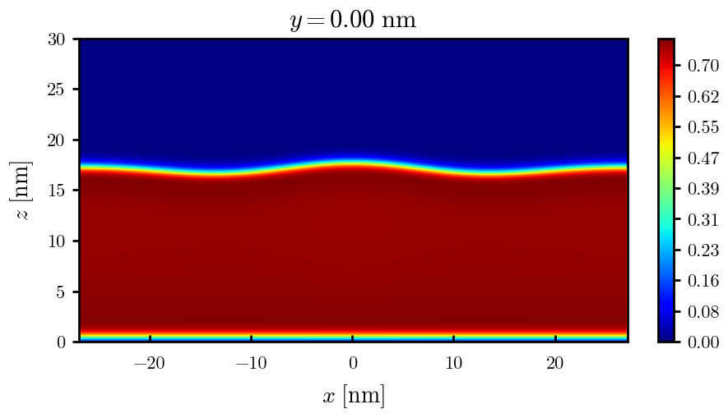
a15s015
F = -8.67754
F = -8.67750

Slide 22
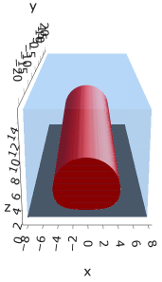
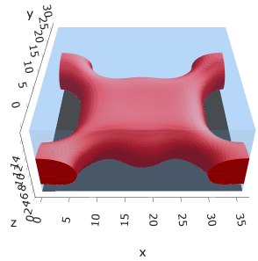
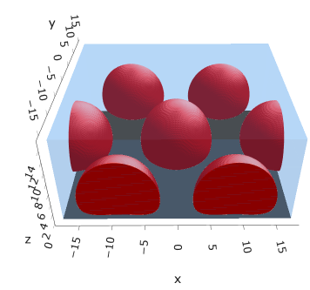
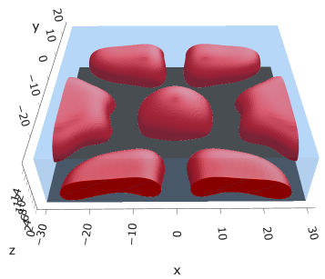
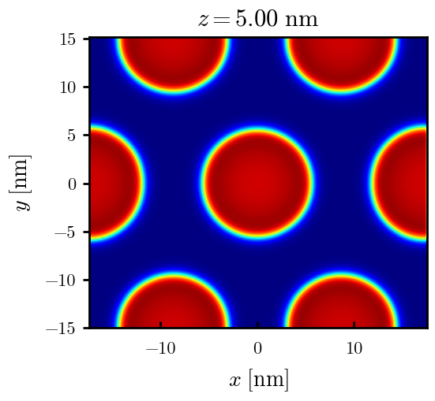
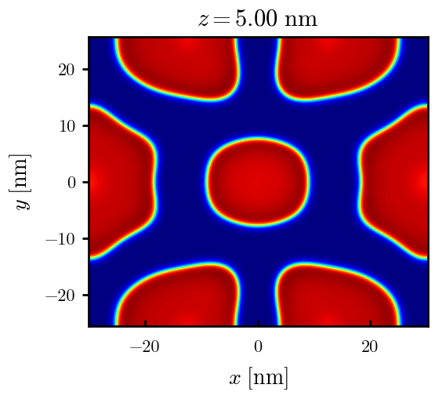
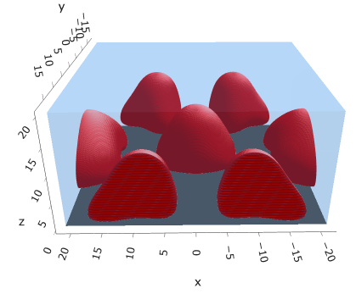
a20s2.5e3
F = -1.41154
F = -1.41046
Np / mic = 1
Np / mic = 2
F = -1.41139
F = -1.41096
F = -1.41105

Slide 23
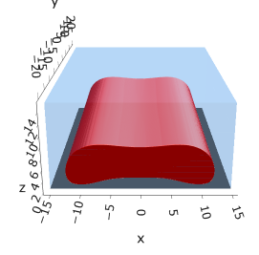
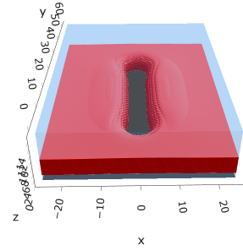
a20s3.5e3
F = -1.97587
F = -1.97575

Slide 24
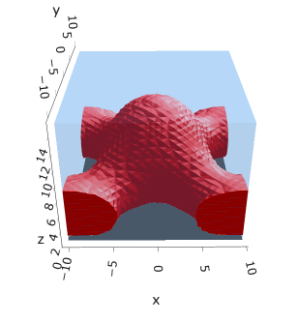
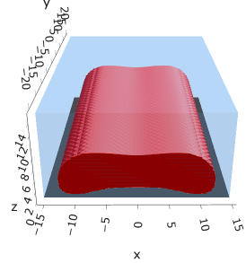

a20s3.75e3
F = -2.11560
F = -2.11697
F = -2.11704

Slide 25






a20s5e3
F = -2.82154
F = -2.82217
F = -2.82208
F = -2.82020

Slide 26


a20s010
F = -5.63481
F = -5.63514

Slide 27





a20s015
F = -8.44011
F = -8.44081
F = -8.43935
F = -8.43930
n_coarse = 2

Slide 28



a20s0175
F = -9.83777
F = -9.83863
F = -9.83859

Slide 29





a20s020
F = -11.2312
F = -11.2319
F = -11.2321
n_coarse = 2

Slide 30



a20s022 – DONE
F = -12.3420
F = -12.3429
F = -12.3433

Slide 31




a20s025 - DONE
F = -14.0028
F = -14.0029
F = -14.0033
F = -13.9755

Slide 32




a20s027 - DONE
F = -15.1049
F = -15.1047
F = -15.0898
F = -15.1050

Slide 33



a225s025
F = -13.7769
F = -13.7774
F = -13.7775

Slide 34




a225s0275
F = -15.1288
F = -15.1293
F = -15.1292
F = -15.1293

Slide 35


a225s030
F = -16.4742
F = -16.4743

Slide 36






a25s2.5e3
F = -1.38218
Np / mic = 1
Np / mic = 2
F = -1.38254
F = -1.38098
F = -1.38073

Slide 37









a25s2.5e3 - cyl

Slide 38



a25s2.5e3 - cyl

Slide 39


a25s3e3
F = -1.66055
F = -1.66046

Slide 40








a25s5e3
Np / cyl = 1
Np / cyl = 2
F = -2.75937
F = -2.75823
F = -2.75546
F = -2.75918
F = -2.75961

Slide 41









a25s010
F = -5.47583
F = -5.48308
F = -5.48466
F = -5.48457
$$z=24 nm$$

Slide 42












a25s015
F = -8.18187
F = -8.17785
F = -8.18516
F = -8.18884
F = -8.18878
F = -8.18865

Slide 43










a25s015 – cyl <> cyl-str
F = -8.18470
F = -8.18421
F = -8.18550
F = -8.18563
F = -8.18589

Slide 44









a25s020
F = -10.8712
F = -10.8748
F = -10.8775
F = -10.8775
F = -10.8766

Slide 45





a25s025
F = -13.5406
F = -13.5450
F = -13.5461
F = -13.5463
F = -13.5461

Slide 46






a25s027
F = -14.6059
F = -14.6065
F = -14.6030
F = -14.6015
F = -14.6022
F = -14.6018

Slide 47







a25s030
F = -16.1888
F = -16.1896
F = -16.1896
F = -16.1854
F = -16.1854
F = -16.1858
F = -16.1857

Slide 48






a25s0325
F = -17.4997
F = -17.4998
F = -17.4968
F = -17.4973
F = -17.4971
F = -17.4975

Slide 49




a25s035
F = -18.8025
F = -18.8025
F = -18.8000

Slide 50



a25s040
F = -21.3805
F = -21.3796

Slide 51




a25s045
F = -23.9208
F = -23.9202
F = -23.9000

Slide 52



a25s050
F = -26.4185
F = -26.4182

Slide 53



a25s055
F = -28.8703
F = -28.8706

Slide 54



a30s0025
F = -1.35320
F = -1.35157

Slide 55


a30s005

Slide 56


a30s010
F = -5.32988
F = -5.33225

Slide 57


a30s015
F = -7.93256
F = -7.93154

Slide 58











a30s020
F = -10.5092
F = -10.5098
F = -10.5108
F = -10.4996
F = -10.4878
F = -10.4764

Slide 59






a30s025
F = -13.0548
F = -13.0657
F = -13.0668
F = -13.0676
F = -13.0394
F = -13.0538

Slide 60







a30s030
F = -15.5953
F = -15.5971
F = -15.5967
F = -15.5886
F = -15.5897
F = -15.5739

Slide 61





a30s0325
F = -16.8494
F = -16.8486
F = -16.8312
F = -16.8491
F = -16.8268
2C isomin = 0.5

Slide 62







a30s035
F = -18.0782
F = -18.0779
F = -18.0943
F = -18.0948
F = -18.0946
F = -18.0887
F = -18.0782

Slide 63










a30s040
dz =0.15
F = -20.5583
F = -20.5585
F = -20.5593
F = -20.5582
F = -20.5549
F = -20.5390
F = -20.5384

Slide 64







a30s045
n_coarse = 2
dz =0.15
F = -22.9834
F = -22.9822
F = -22.9788
F = -22.9692
F = -22.9716

Slide 65





a30s050
dz =0.15
F = -25.3647
F = -25.3647
F = -25.3619
F = -25.3553
F = -25.3480

Slide 66




a30s055
F = -27.6992
F = -27.6993
F = -27.6917
n_coarse = 3

Slide 67


a30s060
F = -29.9840
F = -29.9775

Slide 69




a30s020, chi = 1.35
F = -10.3763
F = -10.3644
F = -10.3602
F = -10.3437

Slide 70





a30s040, chi = 1.35
F = -20.3489
F = -20.3492
F = -20.3446
F = -20.3275
F = -20.3219

Slide 71


a325s020
F = -10.2994
F = -10.2821

Slide 72




a35s020
Cyl?
3 “layers”
+1 dilute layer < isomin = 0.1

Slide 73





a35
s10
s12
s15
s18

Slide 74



Parallelization
$$α=0, χ=1.25, N=50, σ=0.02$$
$$α=0, χ=1.25, N=200, σ=0.005$$
$$L_{x}=L_{y}=23, { L}_{z}=15$$
Nth = 12: 500 it, 4.3 hrs
Nth = 8 : 500 it, 6.9 hrs
Nth = 6 : 415 it, 20 hrs (poss. mem bottleneck)

Slide 75







Exercise: Micelle / Stripe
s = 5e-03, N = 50, a = 0.0, x = 1.0
s = 5e-03, N = 75, a = 0.0, x = 1.0
Isosurface at pha = 0.1

Slide 76






a040x170s020

Slide 77






a040x170s010

Slide 78

a040x170s025

Slide 79














a040x170s022

Slide 80










a040x170 seed
See if becomes hex
cyl4-975
cyl4-12
cyl16-975
cyl16-1025
cyl1

Slide 81






a040x170s017

Slide 82












































a040x170s015 seed
Almost done
Almost done

Slide 83

















a040x170s013

Slide 84
















a040x170s010 seed

Slide 85














X200 x170 x130 x120 x100
F = −10.24458
F = − 9.14301
F = −11.0057
F = −10.2429
F = −11.0015
F = −9.63949
F = −10.2461
F = −10.9948
F = − 9.63030
F = −10.2431
F = −10.9953

Slide 86





a040x100 relaxation

Slide 87








































a040x100 seed
old
old

Slide 88


a040x120 relaxation
F = −10.24458

Slide 89





































a040x120 seed
cyl16-850
cyl16-825

Slide 90






a040x130 relaxation

Slide 91




a040x170 relaxation
F = −9.10347
1 neck

Slide 92







a040x200 relaxation

Slide 93










a040x200 seed
Note: not completely converged but stopped for resources

Slide 95


a0.40 x1.70

Slide 96





Zhulina JCP 1998
a = 0.01
0.1 mM
1 mM
May need to init using sine
10 mM
25 mM
Zhulina NVT; current GCE runs at Lz = 20

Slide 97

Carrillo Langmuir 2009

Slide 98

Parallelization

Slide 99
Equations
Quenched average, np, A --> \inf ; np/A → \sigma
Discrete Gaussian chain

Slide 100




Scaling (Alexander—de Gennes brush)
V = 4.2; H = 27.5 – 30.5
V = 2; H = 39 – 45.5

Slide 101







$φ_{p}$: DGC (3D; NxNy=1) vs MDE (1D)
Ns/sigs: dz = 0.10, Ngz_2 = 4$σ$; Chis/bs: dz = 0.25, Ngz_2 = 3.5$σ$

Slide 102


Numericals
Ys
Possibly do Ngz for multiple dzs

Slide 103








3D
Lxy = 1
Lxy = 10
Lxy = 5
Lxy = 15
y-z heatmaps for $φ_{p}$ at constant x

Slide 104





z-FFT vs z-FD (MDE) – REDFT01 xy(z)
Lx = 5, Ly = 5, Lz = 50. s = 0.02. x = 0.75. a = 0.00, N = 50
3D vs 1D (dashed): dz = 0.5, ds = 0.20; dz_1D = 0.113, ds_1D = 0.083
FFT (xyz)
FFT (yz vs pha)
FD (xyz)
FD (yz vs pha)
Diff btw 1D/3D should just be dz, ds, etc.

Slide 105
Specifying Grafted Points

Slide 106
Strategy
2D binary array for surface sites of homogeneously grafted polymer given grafting density, simulation box size, and discretization (and assuming dx = dy)
Fullspace must be periodic on x0 = xL, y0 = yL
Halfspace must be even on xL/2 and yL/2 (overlap of boundary following REDFT00) and periodic on x0 = xL, y0 = yL.
Homogeneous spacing as determined by regular hexagon, where grafting point at centroid of hexagon
In case there are edge effects, try shifting the centroids away from the boundaries of the xy-plane (only did for fullspace)
Make sure no edge effects by comparing results of full FFT with cos FFT

Slide 107
Test conditions
Sigma = 0.05 c/nm2
Lx = 15 nm
Ly = 15 nm
dx = 0.4 nm
Cast in terms of dx (for rounding and PBC for grafting points):
Sigma = 0.0668 c/nm2
Lx = 14.80 nm
Ly = 11.20 nm
(Sigma error decrease with dx)

Slide 108

Padded PBC (Full FFT)
Hexagons drawn for illustration of hexagon approach

Slide 109

Unpadded PBC (Full/Cos FFT)

Slide 110






Other conditions (full and half results overlapped to show match)
s = 0.0241 (20.28%; dx=0.4), Lx, Ly = 12.40, 20.80
s = 0.0208 (4.08%; dx=0.1), Lx, Ly = 12.90, 22.30
s = 0.1332 (11%; dx=0.1), Lx, Ly = 20.50, 20.40

